Slide 1
PRIME: Preclinical Imaging Centre
US/photoacoustics

Slide 2
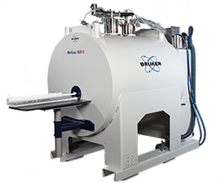
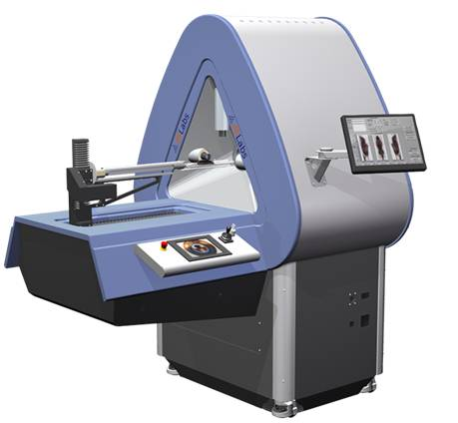
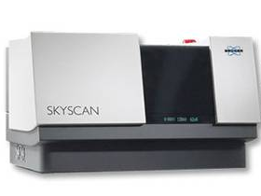
PRIME granted DTL projects
2018 call for Enabling Technology Hotels: five out of six applications granted
2 early career scientist projects
3 public-private partnership projects

Slide 3
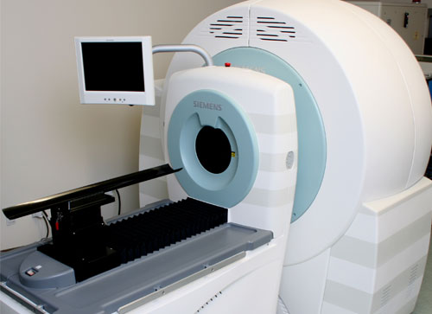
Early career scientist projects
Dr. Antonia Denkova: Radiation and Isotopes for Health group
Novel tumor-targeted nanocarriers for effective delivery of alpha radionuclide therapy
Polymersomes to formulate alpha emitting radionuclides for radionuclide therapy
microPET/CT imaging

Slide 4
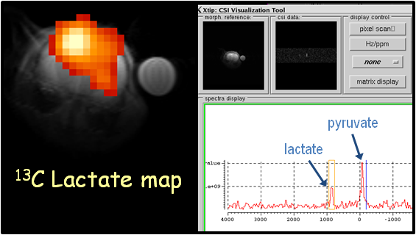
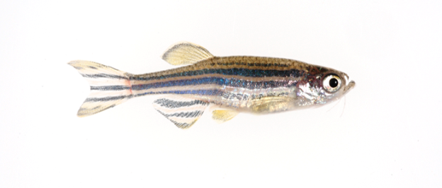
Early career scientist projects
Dr. Martijn Froeling
Hyperpolarized ¹³C pyruvate MRI for metabolic mapping of the failing zebrafish heart
Unique hyperpolariser for increased MR sensitivity to monitor metabolic conversion
Unique expertise MR of zebrafish

Slide 5
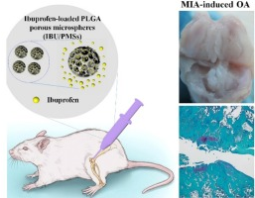
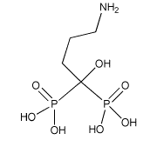
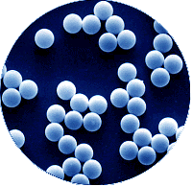
Public-Private partnership project
Dr. Marije Koenders, dept. Rheumatology
Dose finding and efficacy-testing of an osteo-inductive carrier containing alendronate and testosterone in a MIA-induced osteoarthritis rat model.
mouse model osteo arthritis
micro CT imaging

Slide 6
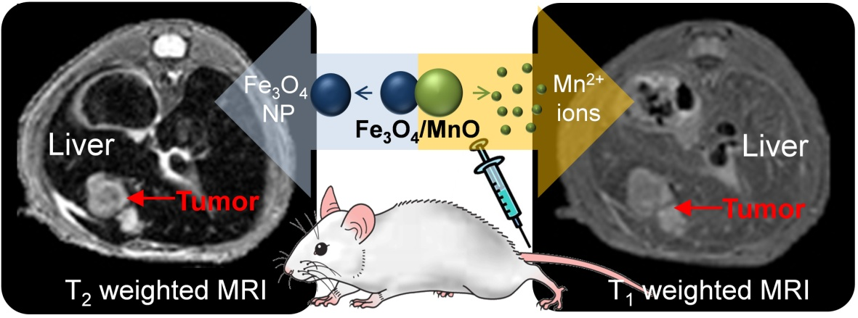
Public-Private partnership project
Dr. J. Paulusse
Hyperpolarization in Nanoparticles Of Silicon (HYPNOS)
Unique hyperpolariser for increased MR sensitivity & innovative detection coils for silicium MR
New perspectives for nanoparticle MR with high sensitivity

Slide 7
Public-Private partnership project
Dr. Marc Robillard
ln vivo chemistry: Evaluation of biocompatible clearing agents for pretargeted radioimmunoimaging.
microSPECT/CT imaging
Pretargeting of cancer
murine tumor models

