Slide 1
Study or Internship abroad BMS & MMD
Cindy van Dijk
International Officer & Erasmus coordinator Radboudumc International Office
Radboud Go Abroad 2021

Slide 2
Program
Radboudumc International Office
Options abroad per study program
Practical Preparation
Brexit!?
COVID-19 internship abroad
Questions

Slide 3
Radboudumc International Office Contact Information
Location: First floor of the Study Center @ StIP (Student Information Point)
Route 84
Half-hour appointments via YouCanBookMe (YCBM)or StiP
Telephone ‘walk-in’ hours: Wednesdays 12:30 - 13:00
T +31 (0)24 361 50 65 / 66 (via StIP),
for short questions (≤10 minutes)
TopDesk: https://radboudumc.topdesk.net/
E-mail: internationalofficestudents@Radboudumc.nl
YCBM: https://rufmwinternationaloffice.youcanbook.me/
Website: www.radboudumc.nl/internationaloffice (click on English)

Slide 4
Options abroad BMS
Internships:
All internships (see Guide Research Internships)
Electives:
Total number of available European Credits (EC) depends on your profile
Courses need to be at least 2 EC
Max 12 EC outside the field of BMS
Max 12 EC on Bachelor level
An elective can also be an extra internship!
Extra curricular: maximum of 30 EC
More info: see “Education and Examination Regulations” (article 11) Approval: required beforehand -> check the meeting dates of the BoE!
Notes:
Research: 27 EC electives (120 – 93) page 23 regulations
Communication/Consultancy: 21 EC for electives (120 – 99) idem

Slide 5
Examples internships BMS
University/Institution abroad | Country
Griffith University, Queensland | Australia
University of British Columbia | Canada
WHO Kopenhagen | Denmark
Deutschen Krebsforschungszentrum | Germany
University of Padjadjaran | Indonesia
University of Rome | Italy
Aichi Cancer Center Research Institute, Nagoya | Japan
Institut Municipal d'Investigacio Medica | Spain
Karolinska Institutet | Sweden
University Hospital Basel | Switzerland
Liverpool School of Tropical Medicine | United Kingdom
Mount Desert Island Biological Laboratory | United States

Slide 6
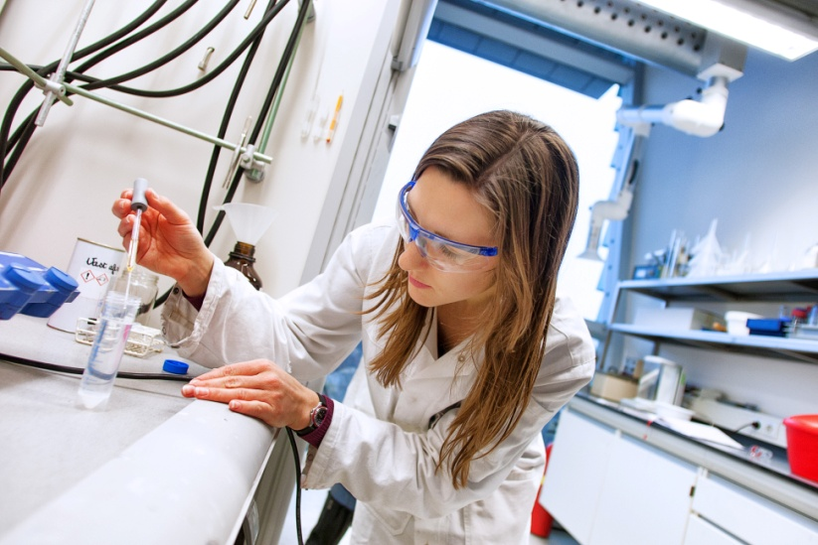
Options abroad MMD
Internships:
First year internship @ IRB in Barcelona
Second year internship, all over the world
Electives*
Theoretical or practical courses in molecular medicine and/or life sciences
At least 1,5 European Credits (EC)
11 or 17 EC in total, depending on chosen research training period
Max 6 EC outside field of MMD (for example career development)
Max 6 EC @ Bachelor’s level to repair knowledge deficiencies
Extra curricular: maximum of 18 EC
More info: Education and Examination Regulations (article 11), Rules and guidelines MMD & Brightspace.
Approval: required 3 weeks before startdate -> check the meeting dates of the BoE!
Notes:
Electives = 11 EC; max 6 EC can be BSc courses

Slide 7
Examples internships MMD
University/Institution abroad | Country
Molecular Genetics of Cancer Division, Melbourne | Australia
Ottawa Hospital Research Institute | Canada
Laboratoire Maladies, Bordeaux | France
German Cancer Research Center (DKFZ, Heidelberg) | Germany
Karolinska Institutet | Sweden
University of Basel | Switzerland
University of Oxford | United Kingdom
King’s College London | United Kingdom
University of Cambridge | United Kingdom
Harvard University | United States
Whitehead Institute for Biomedical Research, Boston | United States
Yale University | United States

Slide 8
Practical preparation
OSIRIS Abroad
Application for study & internship
Study exchange agreements Radboudumc & Radboud University
Practical preparations
Visa
Insurances
Funding:
Radboudumc Studentbudget (faculty scholarsship)
Individual Travel Grant (university scholarship)
Max Planck internship
Erasmus+ grant
External funding

Slide 9
OSIRIS Abroad: study & internship
You have to indicate in “OSIRIS Abroad” whether you want to ga abroad for study or internship.
For internship & study (electives): to secure Radboud University funding
For study (electives) only: to secure a spot at a partner university
Keep in mind:
Approval of an internship or study abroad as part of your studyplan can only be arranged via the BoE, not via OSIRIS Abroad!
Notes:
You are in the lead to start up the application process for any stay abroad, be it internship or study. And your first step is OSIRIS Abroad.

Slide 10
OSIRIS internship application
Apllication for funding
Information required:
Start & end date
Name of the internship institution
Name of the Radboudumc supervisor (for MMD: Helma Pluk)
Name of the supervisor abroad
Document to be uploaded:
Proof of welcome @ your internship location
(e-mail or letter)
Notes:
Once you have submitted this information, we receive a notification and will check your input. If all is correct, we will forward your application to the appropriate scholarship.

Slide 11
OSIRIS study exchange application
Documents to be uploaded:
Motivation Letter
Proof of language level, if already available
Deadline for 1st / 2nd semeseter 2022-2023:
Non-EU -> before February 1st, 2022
EU -> before March 1st, 2022
Instruction on how to apply can be found here
Selection
Based on motivation, language level & grades list
Selection results: non-EU end of February and EU end of April 2022

Slide 12
Radboudumc: EU study agreements
university | country | BMS, MMD | students | months | Language level
University of Antwerp | Belgium | BMS, MMD | 1 | 8 | B2 English
Humboldt University (Charité hospital) | Germany | Master in Medical Neurosciences / Master in Public Health | 1 | 6 | B2 English
Università degli studi di Roma Foro Italico | Italy | European Master in Health and Physical Activity (BMS) | 1 | 3 | A2 English
Lódz University of Technology | Poland | BMS, MMD | 1 | 5 | B2 English
St George’s Hospital Medical School | UK | BMS, MMD | 1* | 6 | B2 English

Slide 13
Radboud University: EU & non-EU study
EU agreements:
university | country | No. students RU wide | Language level
Liverpool John Moore’s University | UK | 8 | B2 English
University of Birmingham | UK | 5 | B2 English
University of Leeds | UK | 3 | B2 English
University of Sussex | UK | 10 | B2 English
University of Glasgow | UK | 6 | B2/C1 English
Non-EU agreements
See the Holland Scholarship webpage of Radboud University for all partners
and for more information on the corresponding Holland Scholarship grant.

Slide 14
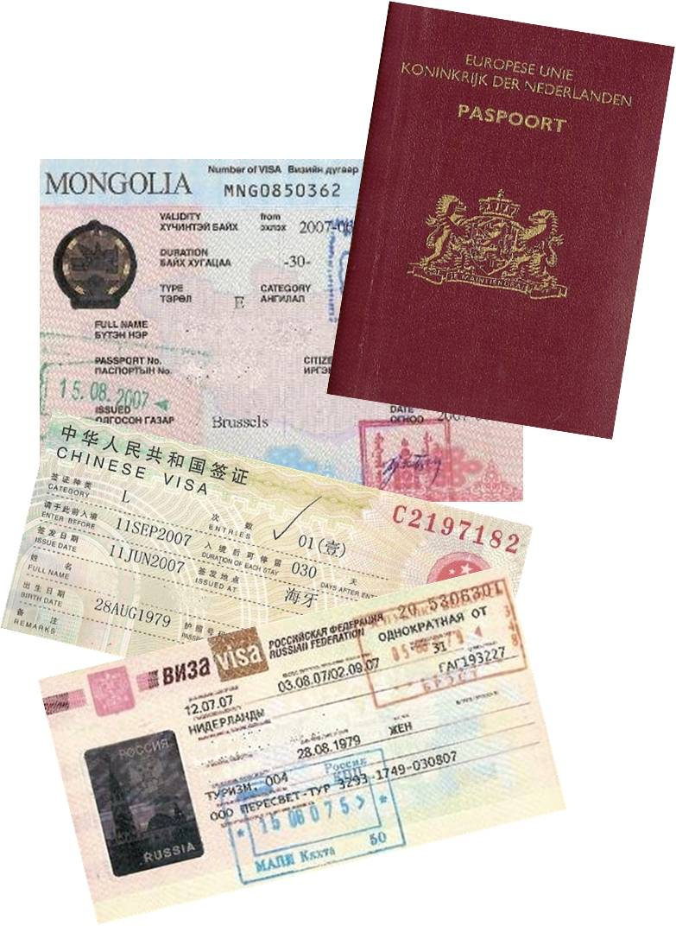
Visa application
Checklist:
Start on time: visa application may take up to 6 months!
Check the embassee /immigration services websites for exact procedures
Required documens:
Evidence of financial independence
Evidence of sufficient insurance coverage
Sometimes also:
Proof of Health
Criminal Records Check
Support letter from Radboudumc International Office
Notes:
Proof of Health – for Canada & Australia only one Dutch family physician/general practitioner is allowed to give out Proof of Health (at a cost of around Euro 250,-)

Slide 15
Insurance
Health insurance
Travel insurance
Personal liability insurance
Accident insurance
Medical liability insurance*
IMPORTANT:
- Check if you have Europe / world coverage!
- Check if internships are also insured!
* When coming in direct contact with test subjects and/or patients

Slide 16
Radboudumc: Studentbudget
Study & internship:
EU € 150,- per month (Switzerland or < 2 months)
non-EU € 200,- per month
Maximum € 600,- per student
Not in combination with Erasmus+!
Can be combined with Individual Travel Grant
Request form available @ StIP frontdesk or online via StIP webpages
Hand in request form @ StIP together with proof of approval by Board of Examiners (e-mail BoE or print-screen Webdossier)
Application starts via StIP Form!

Slide 17
Radboud University: Individual Travel Grant (ITG)
Study or internship:
EU € 200,- per month (max. € 800,-) -> Switzerland
non-EU € 300,- per month (max. € 1.200,-)
Minimum of 2 months, maximum of 4 months
Not in combination with Erasmus+ or Holland Scholarship!
Can be combined with Radboudumc Studentbudget!
Deadline 2 weeks before the start of your internship
For full procedure, see website Radboud University IO
Application starts via OSIRIS Abroad!

Slide 18
Radboud Max Planck Internship
Scholarship for research internships @ European Max Planck Institutes
Minimum of 6 months, maximum of 1 year
Table of Max Planck Institutes: see categories Medicine & Biology
BMS contact: Prof. Frans Russel
MMD contact: Prof. Roland Brock
In combination with Erasmus+ scholarship = € 600,- per month in total
Application starts via OSIRIS Abroad!

Slide 19
European scholarship: Erasmus+
Study & internship
Internship minimum period: 2 months
Study minimum period: 3 months
In total a maximum of 12 months per cycle (BSc, MSc, PhD)
Also possible in the year after graduation*
Amounts depend on host country
Online language test
For more details: see website of the central Radboud International Office
Application starts via OSIRIS Abroad
* apply before graduation!

Slide 20
SEMP scholarship Switzerland
Swiss European Mobility Programme
Swiss version of the Erasmus+ program
For study & for internship
minimum 2 & maximum 12 months
Applications run via the international office of the study- or internship location in Switzerland

Slide 21
External funding examples:
Netherlands Society for Biochemistry and Molecular Biology (NVBMB)
Jong KNCV (Young Royal Dutch Chemical Society; poster competition; Dutch)
Maag, Lever, Darmstichting (Digestive Diseases foundation, Dutch)
Reumafonds (Rheumatism fund, Dutch)
Nationaal MS-fonds (Multiple Sclerose fund, Dutch)
Stichting MS-Research (MS research Foundation, Dutch)
Nierstichting (Kidney foundation, Dutch)
Hartstichting (Heart foundation, Dutch; applications only via Radboudumc contactperson)
Hendrik Muller fonds (Hendrik Muller foundation, Dutch)
Stichting de Fundatie van de Vrijvrouwe van Renswoude te ‘s –Gravenhage (Dutch)

Slide 22
Brexit!?
Scholarhips
UK internship/study up to May 2023: Erasmus+ scholarship
UK internship/study after May 2023: ITG scholarship & Radboudumc Studentbudget
Visa
UK study = Study visa
UK internship = T5 visa
Apply for CoS* number @ British Council via faculty Erasmus coordinator (minimum of 10 weeks before startdate internship)
With the CoS number you then can apply for the T5 visa
Whole process takes about 3 months or more
KEEP AN EYE ON THE RU WEBSITE FOR UPDATES ON BREXIT!
* Certificate of Sponsorship

Slide 23
COVID-19 internship abroad
Current situation d.d. 12 October 2021
Internship is approved (with scholarships):
code green or yellow
You can do your internship physically and on site
At your own risk (no scholarship):
The code is orange
You have approval of your internship plan from the BoE before the start of your internship
Check RU website “Coronavirus & your exchange period” for updates!
Changes are expected soon…

Slide 24
Questions
www.radboudumc.nl/internationaloffice

